Slide 1


Slide 2

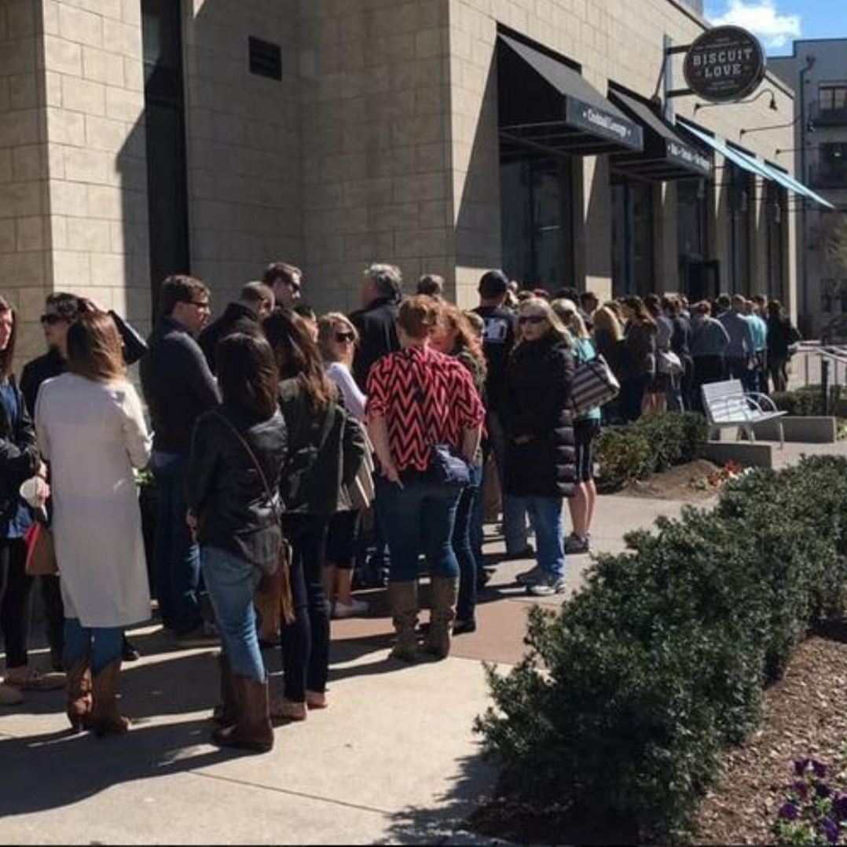



Slide 3
HAVǑL
Restaurant && Home Kitchen Wholesale
www.haveurback.net / 888-999-1234

Slide 4


ACCESS DIFFERENT SHOPS
PRODUCTS
DATABASE
ORDER
BY PROXIMITY
MEET THE NEEDS OF YOUR CLIENTS

Slide 5

FONCTIONALITIES
RESTAURENTS/HOME
Warehouse/shop
Register
Products database
Manipulate database
Insert/delete/update
4. Access order database
1. Access product database of registered shop
Products
Products details
Location
Delivery options
2. Submit orders
3. change your mind
Cancel/update

Slide 6
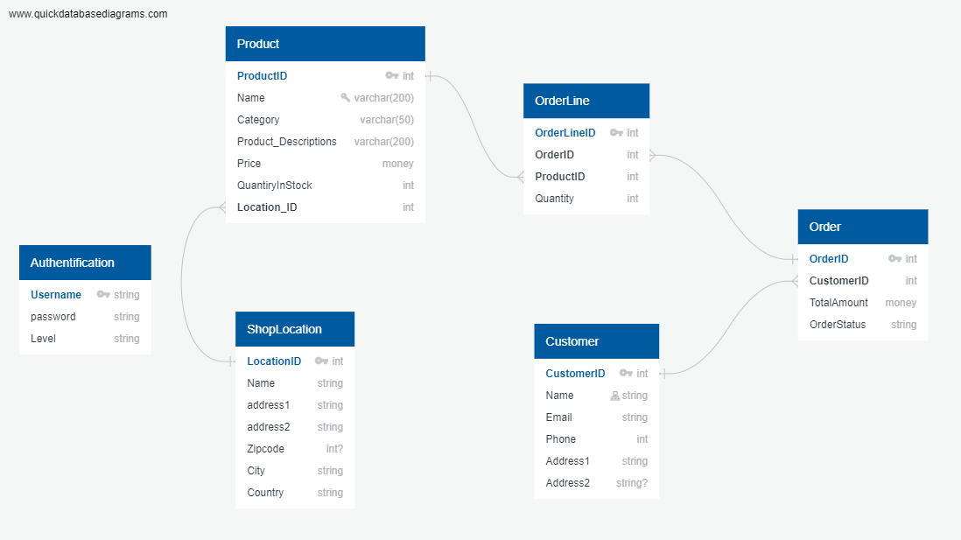
SQL Server Management Studio
Database
Database
Database

Slide 7

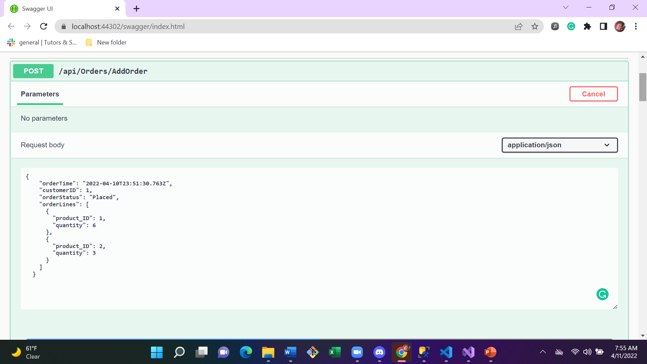

Slide 8
MANIPULATE DATA
MAKE ORDER
MEET THE NEEDS OF YOUR CLIENTS

